Slide 1
Capstone Results
June 18

Slide 2
Case 1
In this case, we simulate the dataset and set the variance of each variable (noise and explanatory) to 0.5 to 5.0 in an interval of 0.5 and display the results of each simulation.

Slide 3
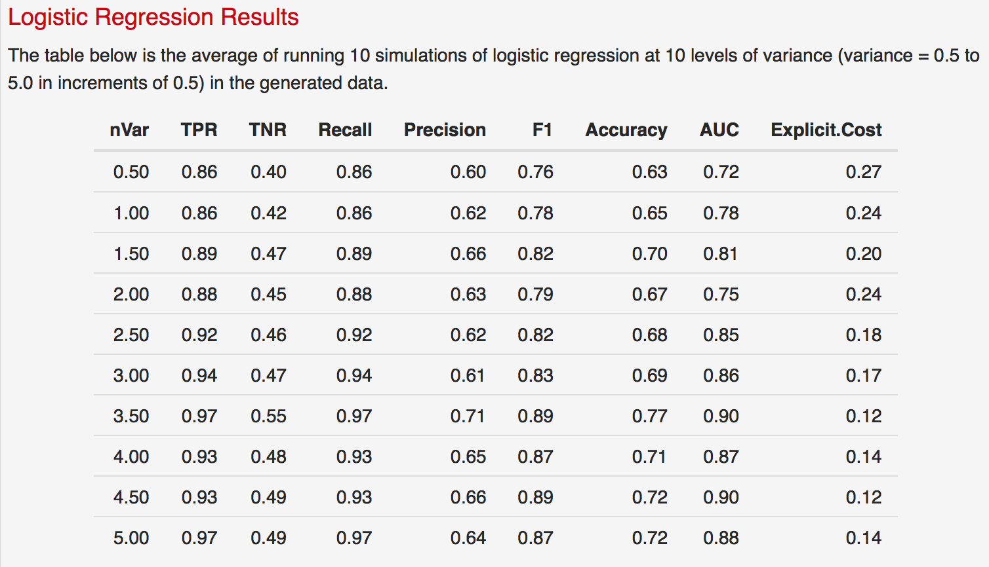
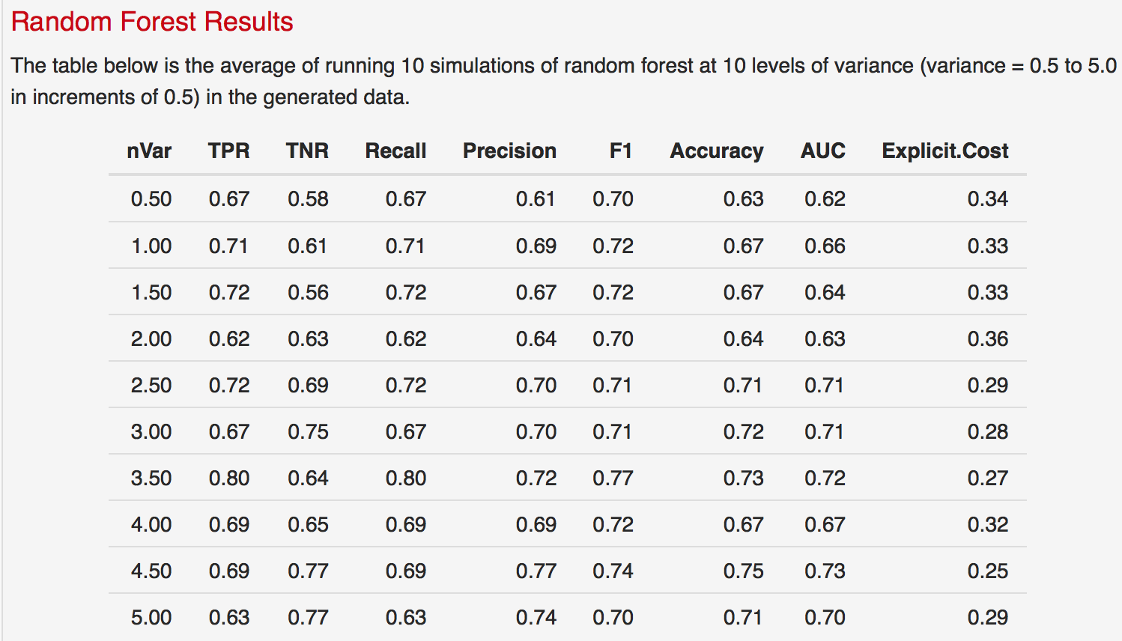
Case 1: 10 Simulations

Slide 4
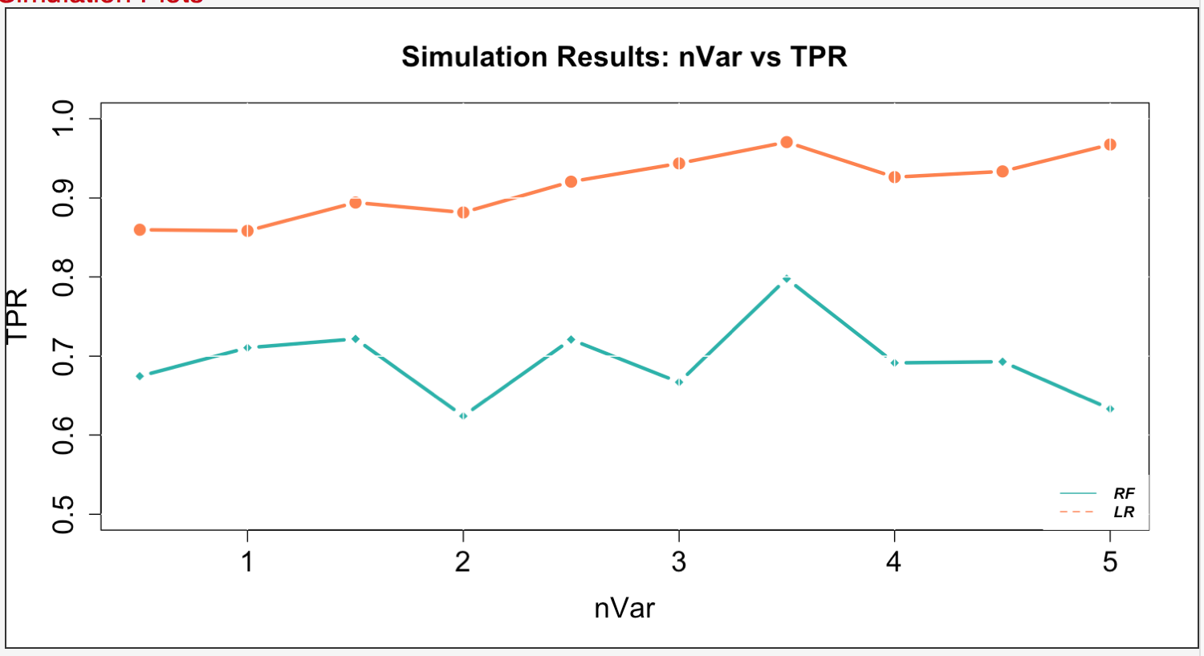
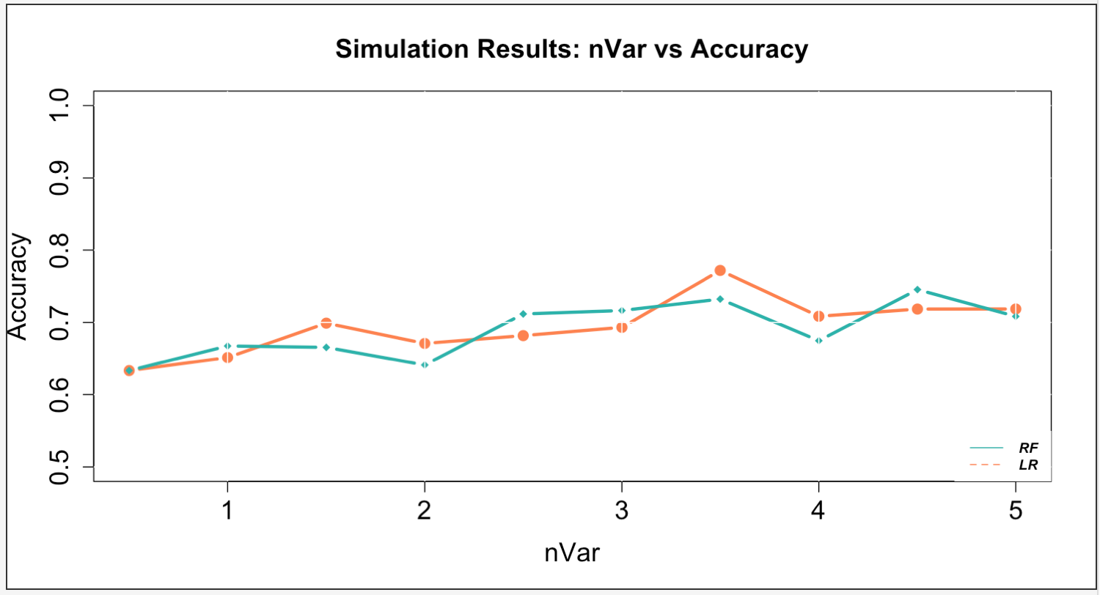
Case 1: 10 Simulations

Slide 5
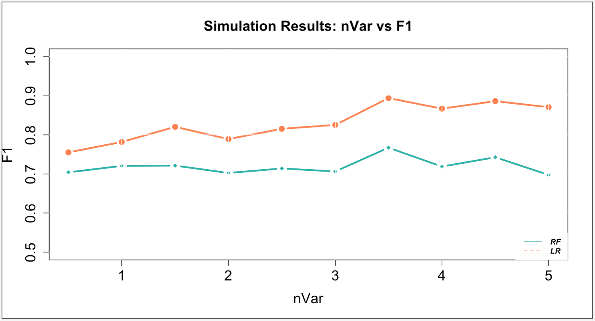
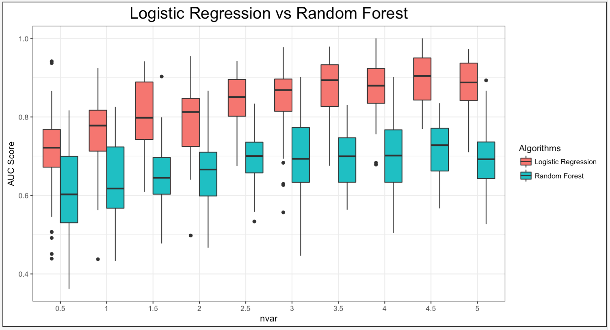
Case 1: 10 Simulations

Slide 6
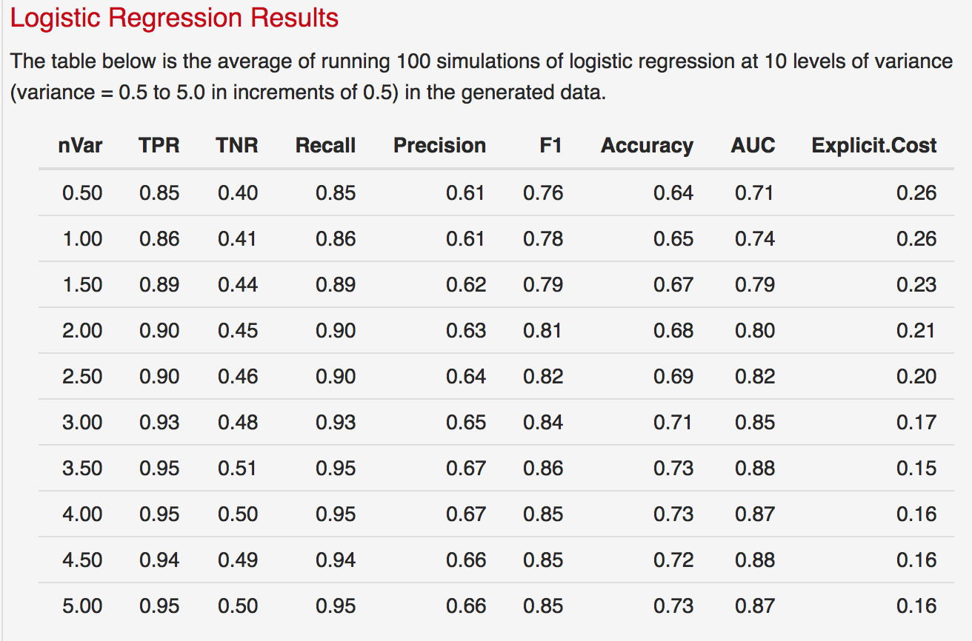
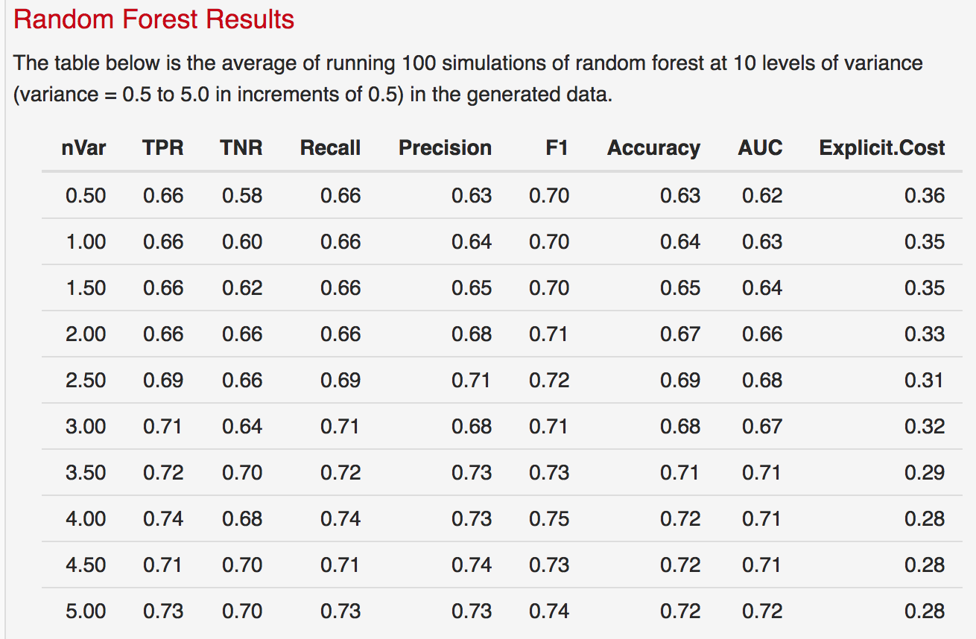
Case 1: 100 Simulations

Slide 7
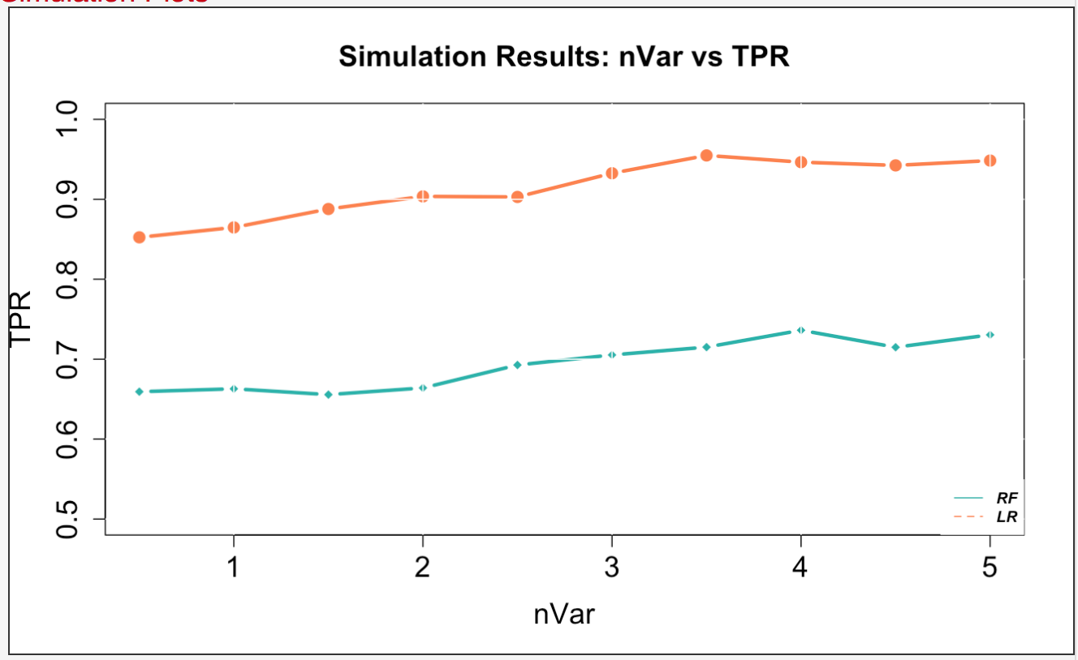
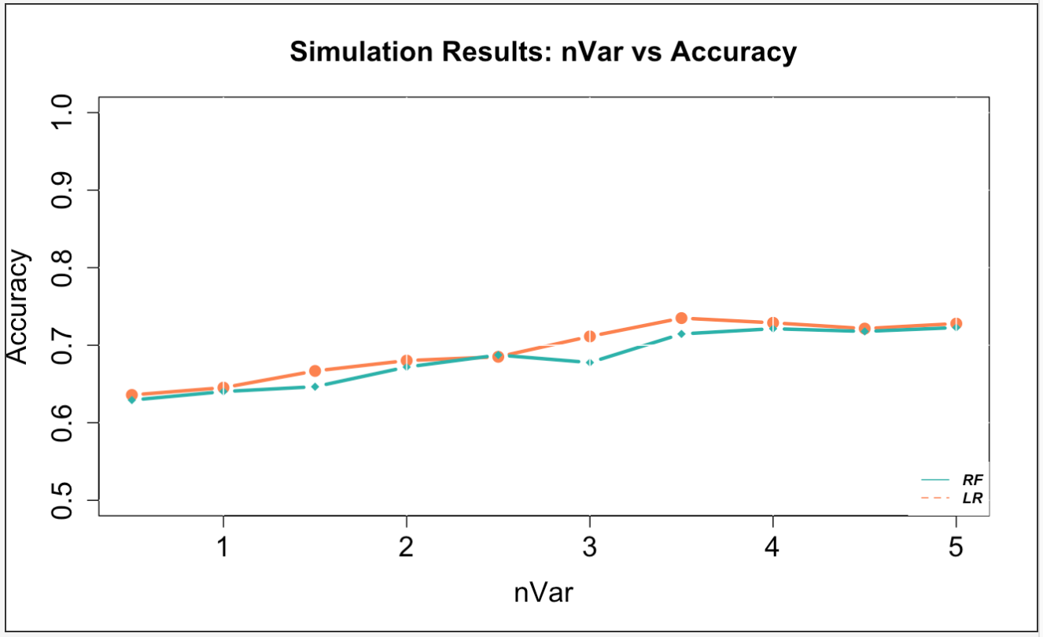
Case 1: 100 Simulations

Slide 8
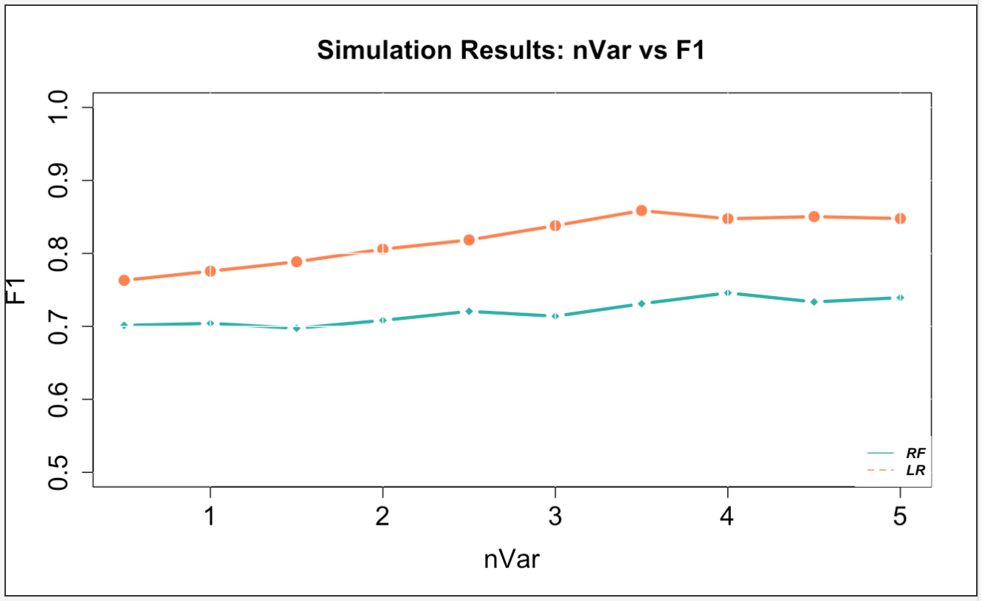
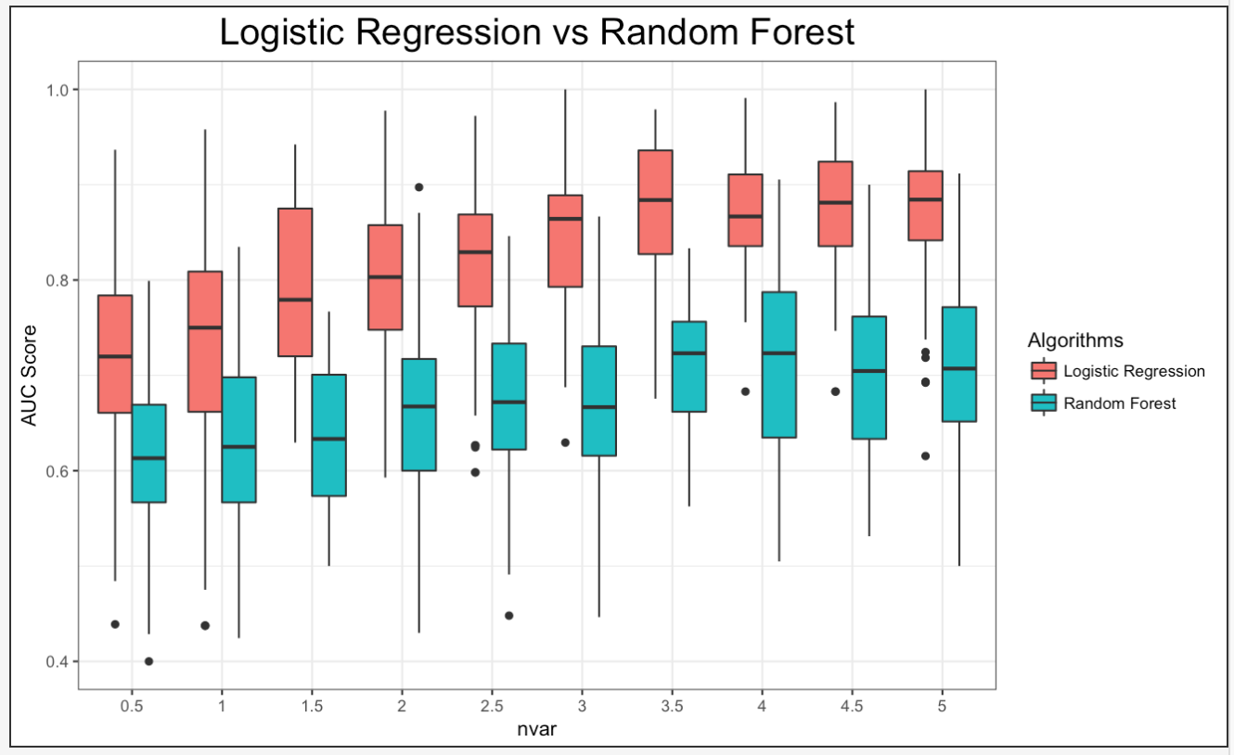
Case 1: 100 Simulations

Slide 9
Case 1: 1,000 Simulations

Slide 10
Case 1: 10,000 simulations

Slide 11
Case 1: 100,000 simulations

Slide 12
Case 2
In this case, we simulate the dataset and set the number of noise variables to 1, 5, 10, 20, and 50 and display the results of each simulation.

Slide 13
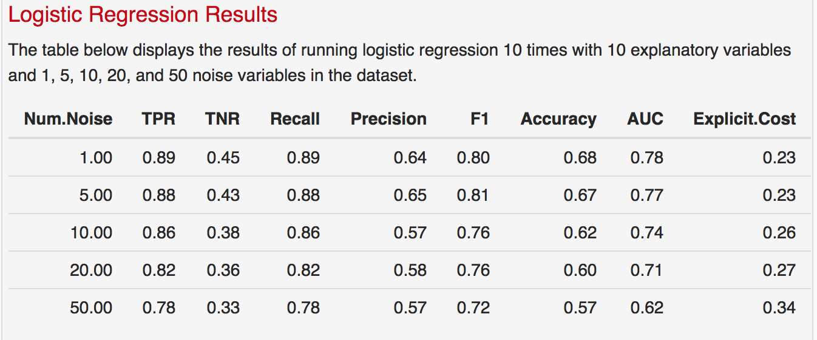
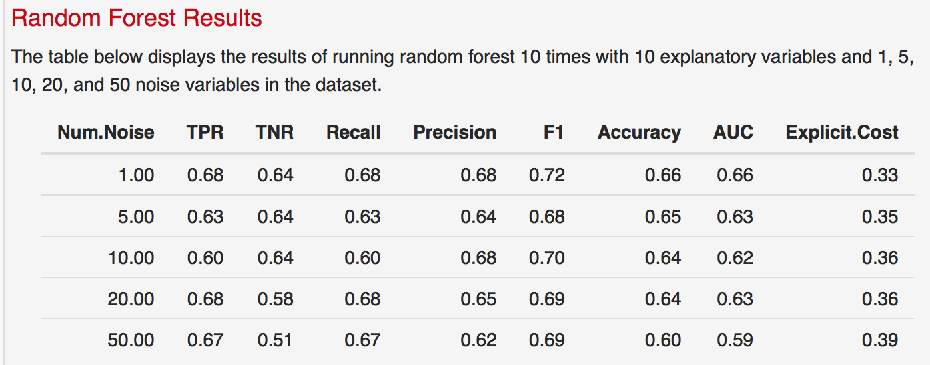
Case 2: 10 Simulations

Slide 14
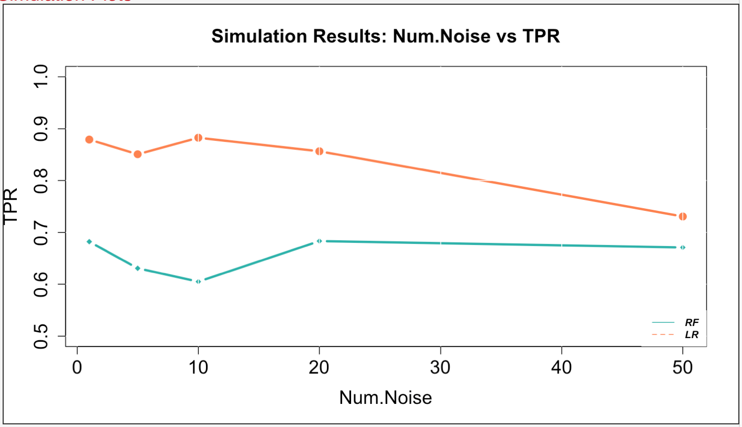
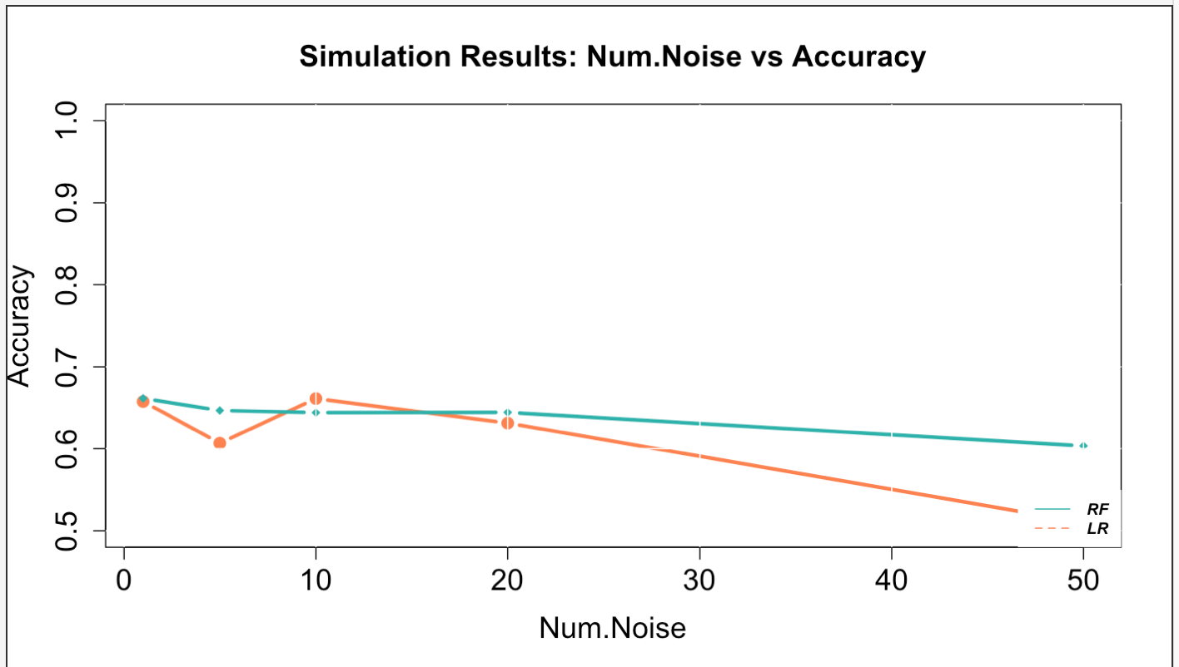
Case 2: 10 Simulations

Slide 15
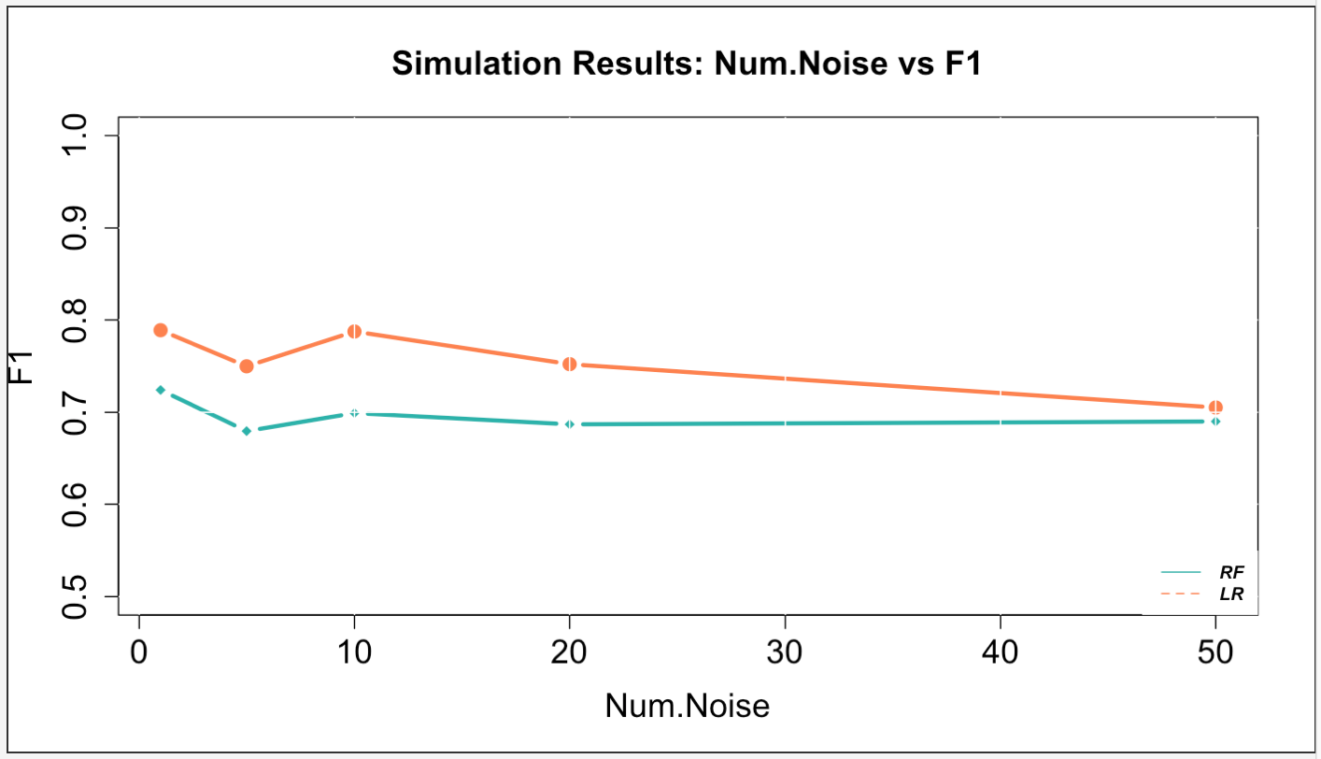
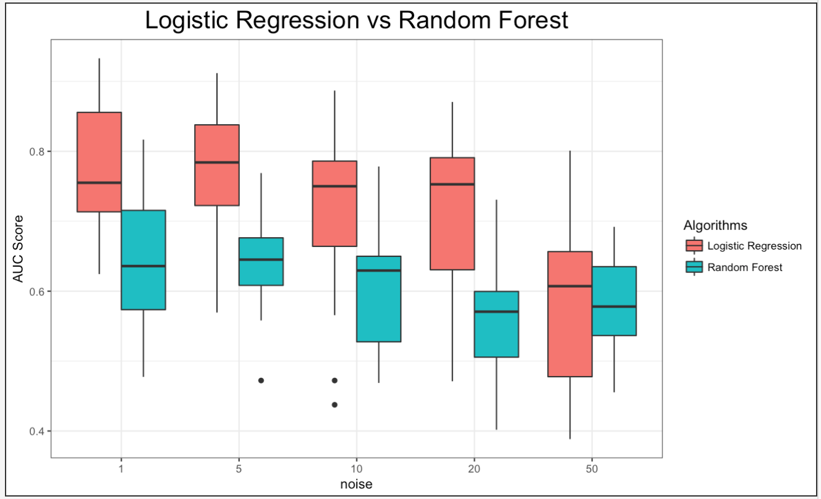
Case 2: 10 Simulations

Slide 16
Case 2: 100 Simulations

Slide 17
Case 2: 100 Simulations

Slide 18
Case 2: 100 Simulations

Slide 19
Case 2: 1,000 Simulations

Slide 20
Case 2: 10,000 simulations

Slide 21
Case 2: 100,000 simulations

